Slide 1
College Technical Math 1
Unit 9 Problems

Slide 2
Unit 9
17.1: Lines and Angles
17.2: Polygons
17.3: Circles and Radians
17.4: Volume and Surface Area

Slide 3
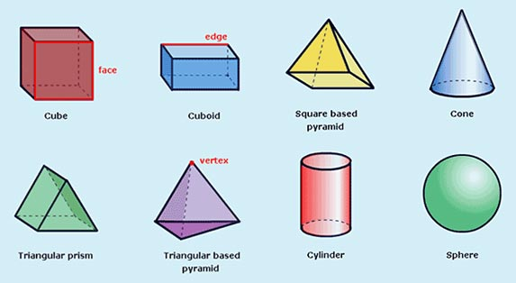
Three Dimensional Objects

Slide 4
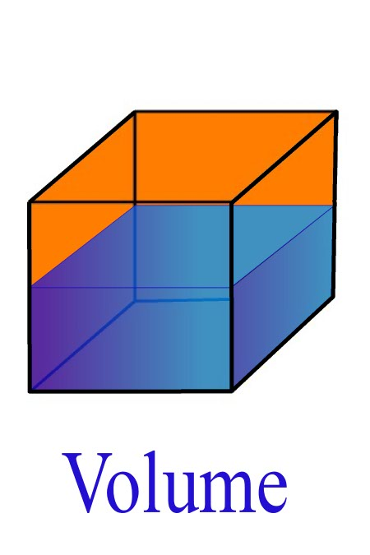
Three Dimensional Objects
Volume – amount of interior space in a three dimensional object.
Typical units:
in³, ft³, yd³, cm³, m³...

Slide 5
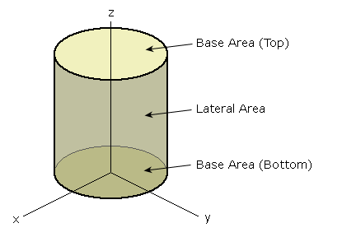
Three Dimensional Objects
Lateral surface area – sum of the surface areas excluding the bases(parallel sides)
Typical units:
in², ft², yd², cm², m²...

Slide 6
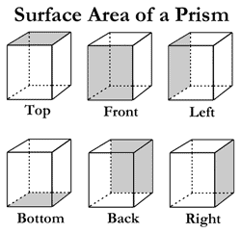
Three Dimensional Objects
Total surface area – sum of the surface areas including the bases

Slide 7
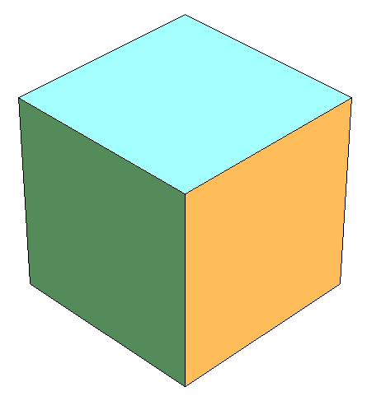
Cube
$$Lateral surface area=4s^{2}$$
s
$$Total surface area=6s^{2}$$
$$Volume=s^{3}$$
s
s
s is the length of a side

Slide 8
Cube
$$Lateral surface area=4s^{2}$$
s
$$LSA=4{(5 in.)}^{2}$$
= 5 in.
$$=100 in2$$
s
s
= 5 in.
= 5 in.

Slide 9
Cube
$$Total surface area=6s^{2}$$
s
$$V=6{(5 in.)}^{2}$$
= 5 in.
$$=150 in.2$$
s
s
= 5 in.
= 5 in.

Slide 10
Cube
$$Volume=s^{3}$$
s
$$V={(5 in.)}^{3}$$
= 5 in.
$$={125 in.}^{3}$$
s
s
= 5 in.
= 5 in.

Slide 11
Right Rectangular Prism
$$Lateral surface area=ph$$
$$\left(2l+2w\right)h =2lh+2wh$$
$$Total surface area=LSA+2B$$
$$=2lh+2wh+2lw=ph +2lw$$
$$h$$
$$w$$
$$Volume=lwh$$
$$l$$
p is the perimeter of the base
h is the height
B is the area of the base

Slide 12
Right Rectangular Prism
$$Lateral surface area=ph$$
$$\left(2l+2w\right)h =2lh+2wh$$
$$LSA=[2\left(8 in. \right)+2\left(4 in. \right)](2 in.)$$
$$h$$
$$=48 in.2$$
$$w$$
= 2 in.
= 4 in.
$$l$$
= 8 in.

Slide 13
Right Rectangular Prism
$$Lateral surface area=ph$$
$$\left(2l+2w\right)h =2lh+2wh$$
$$LSA=[2\left(8 in. \right)+2\left(4 in. \right)](2 in.)$$
$$h$$
$$=48 in.2$$
$$w$$
= 2 in.
= 4 in.
$$l$$
= 8 in.
$$LSA=2\left(8 in.\right)\left(2 in.\right)+2\left(4 in.\right)\left(2 in.\right)$$
$$=32 in.2+16 in.2$$
$$=48 in.2$$

Slide 14
Right Rectangular Prism
$$Total surface area=LSA+2B$$
$$=2lw+2lh+2wh=ph +2lw$$
$$TSA=48 in.2+2\left(8 in. \right)(4 in.)$$
$$h$$
$$=48 in.2+64 in.2$$
$$w$$
= 2 in.
$$l$$
= 8 in.
$$=112 in.2$$
= 4 in.

Slide 15
Right Rectangular Prism
$$Volume=lwh$$
$$=(8 in.)(4 in.)(2 in.)$$
$$=64 in.3$$
$$h$$
$$w$$
= 2 in.
= 4 in.
$$l$$
= 8 in.

Slide 16
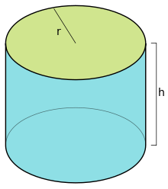
Right Circular Cylinder
$$Lateral surface area=ph=2πrh$$
$$Total surface area=ph+2B$$
$=2πrh+2$𝜋r²
$$Volume=πr^{2}h$$
p is the perimeter of the base
h is the height
B is the area of the base

Slide 17
Right Circular Cylinder
$$Lateral surface area=ph=2πrh$$
$$=2π(5 in.)(8 in.)$$
= 5 in.
$$=251.3 in.2$$
(rounded)
= 8 in.
$$Total surface area=ph+2B$$
$=2πrh+2$𝜋r²
$$=251.3 in2+2π\left(5 in.\right)2$$
$$=251.3 in2+157.2 in2$$
$$=408.5 in.2$$
(rounded)

Slide 18
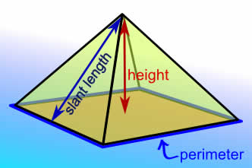
Square Pyramid
$$Lateral surface area=\frac{1}{2}ps$$
$$Total surface area=\frac{1}{2}ps+B$$
$$Volume=\frac{1}{3}Bh$$
p is the perimeter of the base
h is the height
s is the slant height
B is the area of the base

Slide 19
Square Pyramid
$$Volume=\frac{1}{3}Bh$$
$$=\frac{1}{3}[(10 cm)\left(10 cm)](8 cm\right)$$
= 8 cm
$$=266.7 cm3$$
= 10 cm
(rounded)

Slide 20
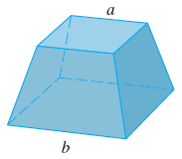
Frustum of a Square Pyramid
$$B_{2}$$
$$Volume=\frac{1}{3}h\left(B_{1}+B_{2}+\sqrt{B_{1}B_{2}} \right)$$
$$h$$
h is the height
$B_{1}$ is the area of one base
$B_{2}$ is the area of the second base
$$B_{1}$$

Slide 21
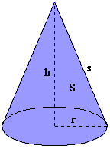
Right Circular Cone
$$Lateral surface area=πrs$$
$$Total surface area=πrs+πr^{2}$$
$$Volume=\frac{1}{3}Bh=\frac{1}{3}πr^{2}h$$
s is the slant height
h is the height
r is the radius of the base

Slide 22
Right Circular Cone
$$Volume=\frac{1}{3}Bh=\frac{1}{3}πr^{2}h$$
$$=\frac{1}{3}π\left(4 cm\right)2\left(9 cm\right)$$
= 9
cm
$$=150.8 cm3$$
(rounded)
= 4 cm

Slide 23
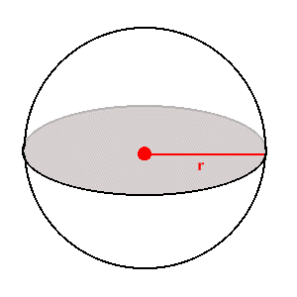
Sphere
$$Total surface area=4πr^{2}$$
$$Volume=\frac{4}{3}πr^{3}$$

Slide 24
Sphere
$$Total surface area=4πr^{2}$$
$$=4π\left(4.695 in.\right)2$$
= 4.695 in.
$$=277.0 in2$$
(rounded)
Note: This is the radius of a basketball.

Slide 25
Sphere
$$Volume=\frac{4}{3}πr^{3}$$
= 4.695 in.
$$=\frac{4}{3}π\left(4.695 in.\right)3$$
$$=433.5 in3$$
(rounded)
Note: This is the radius of a basketball.

Slide 26
Practice Problems
Find the volume.
3 in
5 in
7 in
$$Answer: 105 in3$$

Slide 27
Practice Problems
How many cubic inches are in a right circular cylinder with a diameter of $4\frac{1}{2} in$ and a height of $12 in.$
$$Answer: 190.9 in3$$
(rounded)

Slide 28
Practice Problems
Find the volume.
30 ft =
= 15 ft
$$Answer:7068.6 ft3$$
(rounded)

